Slide 1
Chapter 4
Linguistic application of classification

Slide 2
Question :
“What are the classical application of text classification?”
Answer:
“ Sentiment and opinion analysis, and Word sense disambiguation”

Slide 3
Sentiment analysis
Sentiment analysis is a classical application of text classification, and is typically approached with a bag-of-words classifier.
Now let's define the sentiment of a text and what do we mean by that?
The sentiment behind a text refers to the author’s subjective or emotional attitude towards the central topic of the text.
Some good examples of semantics behind natural language texts can be found in:
In consumer reviews of a product or service, the sentiment behind the review may align with a 1-5 star rating.
In political statements, the sentiment may reflect a favorable/ unfavorable view toward a proposed policy

Slide 4
Sentiment analysis pt2
As we mentioned, a typical way to approach sentiment analysis is through BOW classification.
However, there are some cases of linguistic phenomena which require more complex modeling.
Some examples of such linguistic phenomena are provided here for clarification; in these examples we can clearly see that using double negation in speech or sometimes slangs will require more complex classifier than BOW to figure out the sentiment behind one’s sentence.
Example 1 → It would be nice if you acted like you understood.
Example 2 → That’s not bad for the first day.
Example 3 → It's not like I don't agree with your teacher.

Slide 5

Word sense disambiguation
Many words have multiple senses, or meanings. The semantic behind those texts which consisting of of multi-sense words, will associate with only one of the senses of those words.
Example: the verb appeal has different senses. The real question is how a model can find out the correct sense of the verb appeal in the following text.
Text → “Prostitutes appeal to Pope”

Slide 6
Word sense disambiguation pt2
Word senses disambiguation is the problem of identifying the intended word sense in a given context.
Senses are properties of lemmas which are uninflected word forms, and are grouped into synonym sets called synsets.
These synsets are collected and annotated in WordNet. WordNet consists of roughly 100,000 synsets, which are groups of lemmas (or phrases) that are synonymous.
WordNet defines the scope of the word sense disambiguation problem, and, more generally, formalizes lexical semantic knowledge of English.

Slide 7
Word sense disambiguation pt3
WordNet also describes many other lexical semantic relationships in addition to synonymy, including:
Antonymy: x means the opposite of y, e.g. FRIEND-ENEMY
Hyponymy: x is a special case of y, e.g. RED-COLOR; the inverse relationship is hyponymy
Meronymy: x is a part of y, e.g., WHEEL-BICYCLE; the inverse relationship is holonymy.
Classification of these relations can be performed by searching for characteristic patterns between pairs of words.

Slide 8
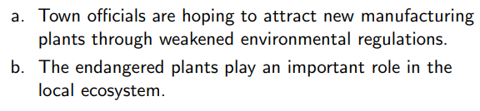
Word sense disambiguation as Classification
Consider the the mentioned two texts bellow
Different senses of word “plants” has been used in each sentences.
How can we tell living plants from manufacturing plants?

Slide 9

Word sense disambiguation as Classification pt2
Now lets build a feature vector using the bag-of-words representation, by treating each context as a pseudo-document.
The feature function can be represented as following:

Slide 10
Word sense disambiguation as Classification pt3
As in document classification, many of these features are irrelevant, but a few are very strong predictors.
To go beyond the bag-of-words, one might encode the position of each context word with respect to the target. These are called collocation features, and they give more information about the specific role played by each context word.
A semantic concordance is a corpus in which each open-class word (nouns, verbs, adjectives, and adverbs) is tagged with its word sense from the target dictionary or thesaurus

Slide 11
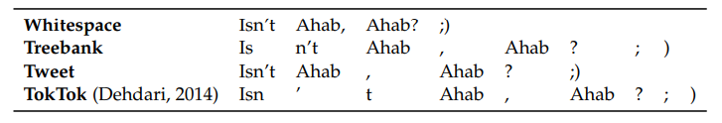
Tokenization
The first subtask for constructing a bag-of-words vector is Tokenization.
Tokenization is the language-specific task of splitting the input into discrete tokens.
A simple approach is to define a subset of characters as whitespace, and then split the text on these tokens.
Text → “Isn’t Ahab, Ahab? ;) “

Slide 12
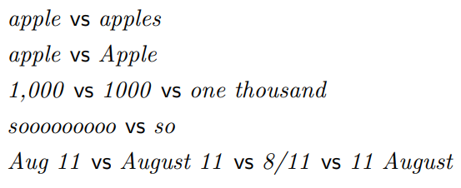
Normalization
After splitting the text into tokens, the next question is which tokens are really distinct.
For example, sentence-initial capitalization may be irrelevant to some classification tasks.
The complete elimination of case distinctions will result in a smaller vocabulary, and thus smaller feature vectors.
Other than Normalization, there are aggressive ways to group words like Stemming and Lemmatization.

Slide 13
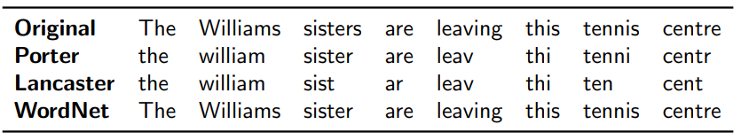
Stemmer and Lemmatizer
A stemmer is a program for eliminating affixes, usually by applying a series of regular expression substitutions.
There are different stemming and Lemmatizer algorithms, the most popular ones are “Porter”, “Lancaster” , and “WordNet”.
Lemmatizers are systems that identify the underlying lemma of a given wordform. They must avoid the over-generalization errors of the stemmers.

Slide 14
Stopwords
Another way to reduce the size of the feature space is to eliminate stopwords such as “the”, “to”, and “and”, which may seem to play little role in expressing the topic, sentiment, or stance.
This is typically done by creating a stoplist (e.g., NLTK.CORPUS.STOPWORDS), and then ignoring eliminating all terms that match the list from the text.

Slide 15
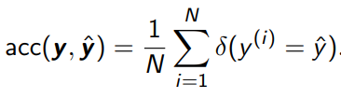
Evaluating your Classifier
Similar to any supervised machine learning application, we use our reserved balanced testing data to evaluate the overall accuracy of our model.
Other than “accuracy” which indicates how often our model is right, we need additional metrics for further analysis on the response of our model on testing set.

Slide 16
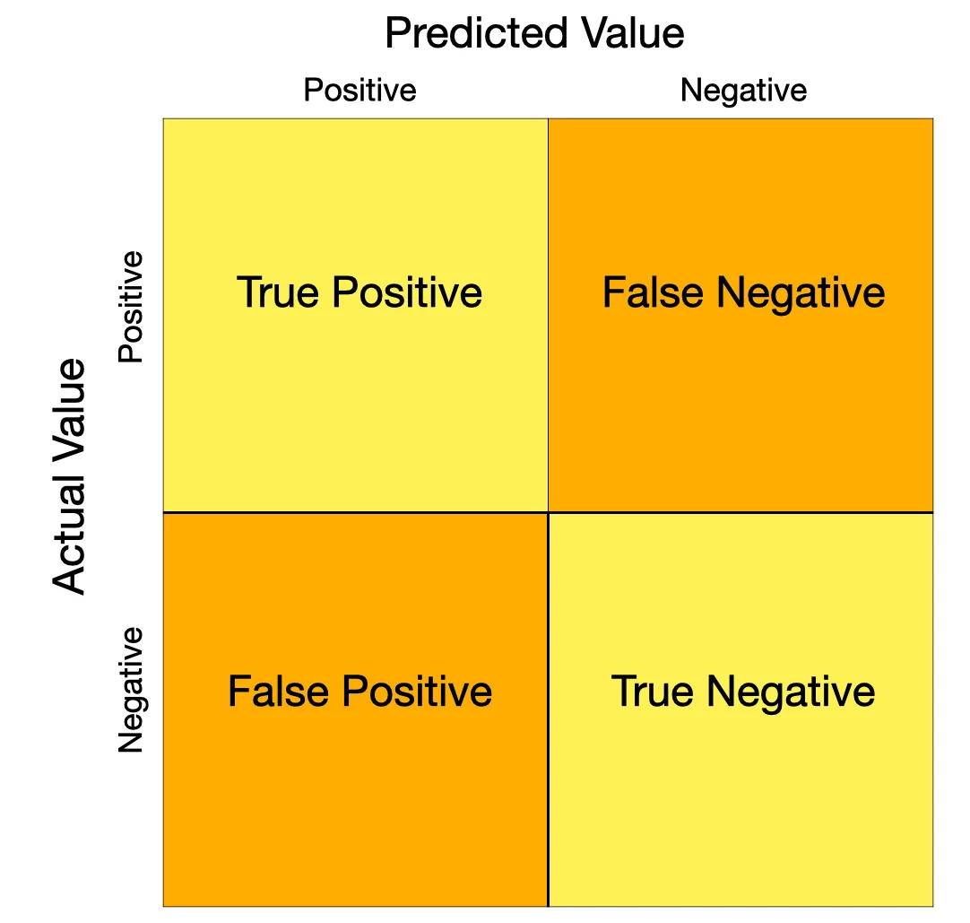
Other Evaluating Metrics
False positive: the system incorrectly predicts the label.
False negative: the system incorrectly fails to predict the label.
True positive: the system correctly predicts the label.
True negative: the system correctly predicts that the label does not apply to this instance.
Recall and precision are defined in terms of these counts, and distinguish between the two types of errors.

Slide 17



Recall, Precision,and their Combination
Recall and precision n imply binary classification as they are defined in terms of FP, FN, TP,TN counts.
Recall is the fraction of positive instances which were correctly classified.
Precision is the fraction of positive predictions that were correct.
F-measure can be defined as the combination of Recall and Precision when they are weighted equally.

Slide 18
Evaluating Multi-class Classification
In multi-class classification, each instance is positive for one class, and negative for all other classes.
Macro F-MEASURE is the average F-MEASURE across several classes.
In multi-class problems with unbalanced class distributions, the macro F-MEASURE is a balanced measure of how well the classifier recognizes each class. This treats all classes equally, regardless of their frequency as its balanced across classes.

Slide 19
Evaluating Multi-class Classification pt2
In Micro F-MEASURE, we compute true positives, false positives, and false negatives for each class
Then add them up to compute a single recall, precision, and F-MEASURE.
This metric is balanced across instances rather than classes, so it weights each class in proportion to its frequency. This emphasizes performance on high-frequency classes.

Slide 20
Classifier Comparison
Suppose we have learned multiple models to solve our problem and we achieved different accuracy values for each. How can we compare them with each other?
The main aim of hypothesis testing is to determine whether the difference between two statistics, for example, the accuracies of two classifiers,is likely to arise by chance.
We will be concerned with chance fluctuations that arise due to the finite size of the test set.

Slide 21
Classifier Comparison pt2 : Hypothesis testing
Example: Suppose two model classifiers to solve a problem, first model, C1 gets 82% accuracy with 1000 examples in the test set, and second model C2 gets 73% accuracy with 11 examples in the test set.
Now let's consider two hypotheses that explain the observed data:
H0 → C1 is not more accurate than C2, and its superior performance on the test set was due only to luck. This is the null hypothesis.
H1→ C1 is more accurate than C2, and therefore can be expected to be more accurate in the future (in the limit of an infinite number of independent evaluations).

Slide 22
Classifier Comparison pt2 : Hypothesis testing
C1 gets 82% accuracy with 1000 examples in the test set.
C2 gets 73% accuracy with 11 examples in the test set.
[H0 → C1] is not more accurate than C2, and its superior performance on the test set was due only to luck. This is the null hypothesis.
[H1 → C1] is more accurate than C2, and therefore can be expected to be more accurate in the future (in the limit of an infinite number of independent evaluations).
If the test set is small, H0 might be true. If the test set is large, the probability of observing a 9% difference in accuracy becomes vanishingly small unless C1 really is more accurate.
These probabilities are quantified by hypothesis testing.

Slide 23

Classifier Comparison pt3: The Binomial test
The statistical significance of a difference in accuracy can be evaluated using classical tests, such as the binomial test.
Under the null hypothesis, when the classifiers disagree, each classifier is equally likely to be right so θ=0.5. Therefore, among N disagreements, c1 is correct k < N/2 times.

Slide 24
Classifier Comparison pt3: The Binomial test
Suppose that classifiers c1 and c2 disagree on N instances in a test set with binary labels, and that c1 is correct on k of those instances.
Under the null hypothesis that the classifiers are equally accurate, we would expect k/N to be roughly equal to 1/2, and as N increases, k/N should be increasingly close to this expected value.
These properties are captured by the binomial distribution, which is a probability over counts of binary random variables.

Slide 25
Building datasets
If you want to build a classifier, sometimes you must first build a dataset of your own.
The goal is to build a system that will work across a broad range of documents. In this case, it is best to have a balanced corpus, with contributions from many styles and genres.
Sometimes building corpus or dataset includes selecting a set of documents or instances to annotate, and then performing the annotations.
One important part of building a balanced corpus is to get the labels of the dataset.
Text classification relies on large datasets of labeled examples by exploiting metadata to obtain labels , or using annotations as the labels.

Slide 26
Building datasets: Labeled dataset
Text classification relies on large datasets of labeled examples. There are two ways to get labels.
By exploiting existing metadata to obtain labels. Metadata sometimes tell us exactly what we want to know.
Using annotations as the labels must be annotated, either by experts or by novice “crowdworkers.”

